Slide 1
Student at math oral examination
Professor
Student

Slide 2
Student at math oral examination
What is 1+4?
Professor
Student
What is 1+4*2?
What is 1+4, 3*2?
What is the diagonal of square with side of size 1?

Slide 3
Student at math oral examination
Professor
Student

Slide 4
Let’s fix the student!
Student

Slide 5

Arithmetic logic unit (ALU)

Slide 6
Arithmetic logic unit (ALU)
What is 1+4?
5!
What is 1+4*2?
8 …

Slide 7
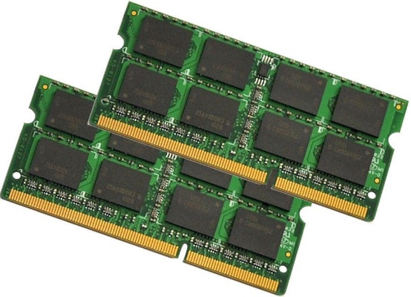
Arithmetic logic unit (ALU) + RAM

Slide 8
Arithmetic logic unit (ALU) + RAM
What is 1+4?
5 !
What is 1+4*2?
9 !
What is 1+4, 3*2?
6 .. eeh

Slide 9
ALU + RAM + PC (program counter)
PC

Slide 10
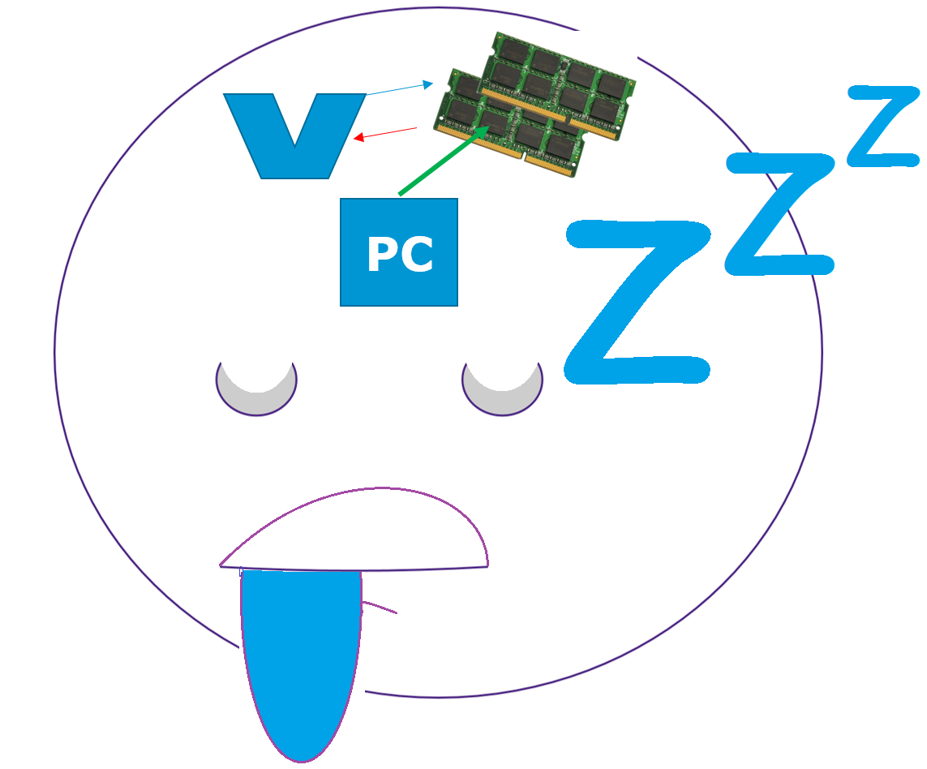
ALU + RAM + PC (program counter)
What is 1+4, 3*2?
PC
5 and 6 !
What is 1+3, 1+55*2, 15/5?
4, 111, and ..
.. ZZzzzZ

Slide 11
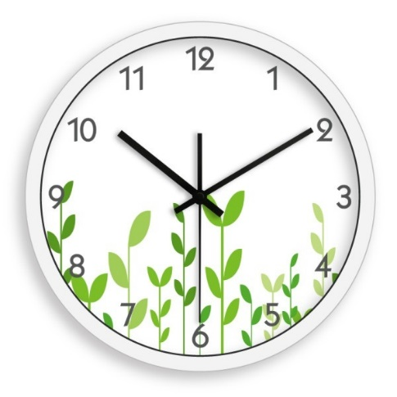
ALU + RAM + PC + Clock
Don’t sleep! Do everything step by step!
What is 1+3, 1+55*2, 15/5?
PC
4, 111, and 2!

Slide 12
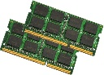

Student at math oral examination
Professor
But the student still knows only how to add numbers…
Student
PC
What about Pythagorean theorem, derivatives?

Slide 13
Student at math oral examination
Professor

Slide 14

Student at math oral examination
IDEA
Let’s teach the student!
Right from the start!
Professor

Slide 15


Student at math oral examination
Elementary school | Assembler
Student

Slide 16

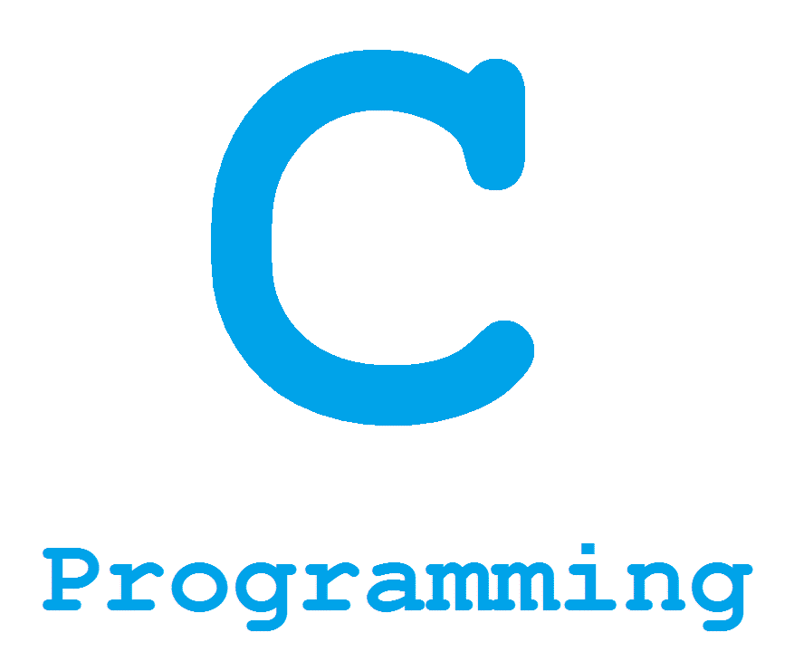
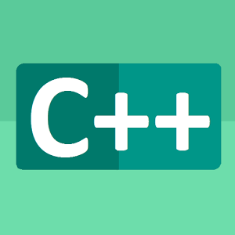
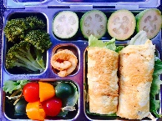
Software!
Elementary school | Assembler
High school | Low level languages
Student

Slide 17







Software!
Elementary school | Assembler
High school | Low level languages
University | High Level Languages
FINALLY! My student is ready for life!
Student
Professor

Slide 18




Software!
I am doing something useful
Elementary school | Assembler
High school | Low level languages
University student | High Level Languages
PhD | Machine learning
PhD
Student

Slide 19
Software!
I am doing something useful
Elementary school | Assembler
High school | Low level languages
University student | High Level Languages
PhD | Machine learning
Machine able to alter its own instructions
PhD
Student

Slide 20
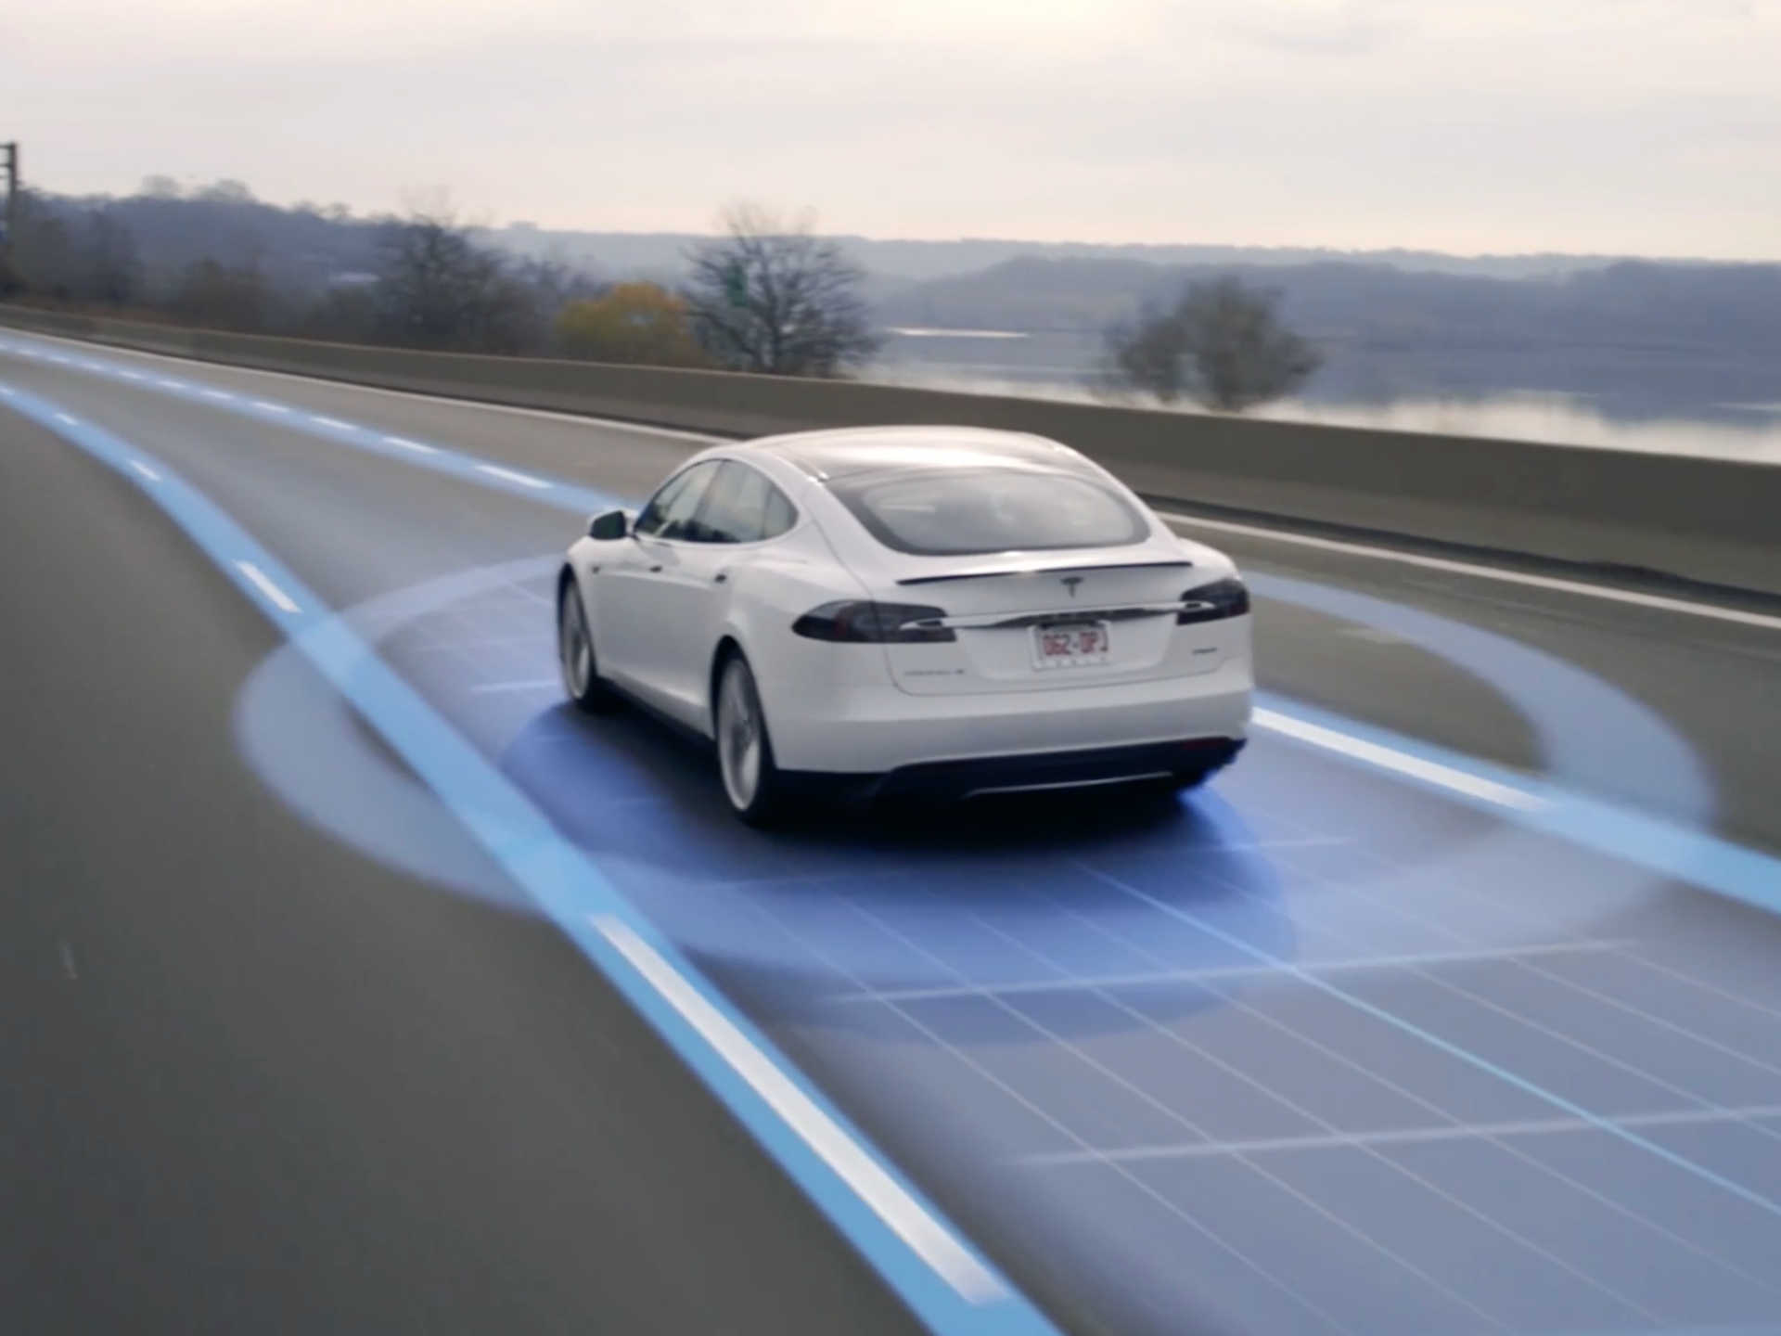
Autonomous cars
Video

Slide 21

Image processing

Slide 22
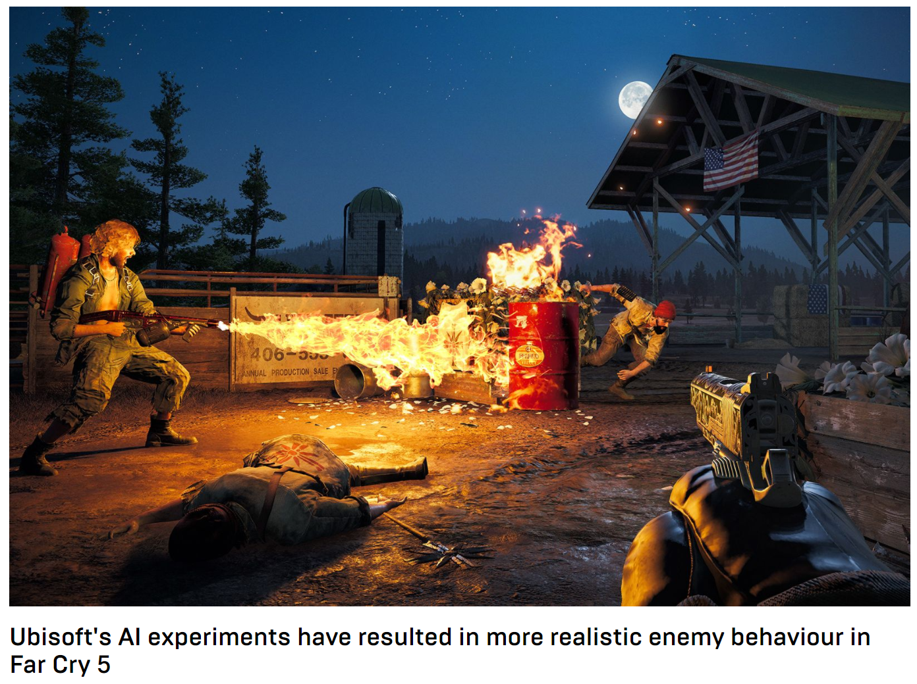
Bug fixing in applications

Slide 23

Software learns to write software

Slide 24
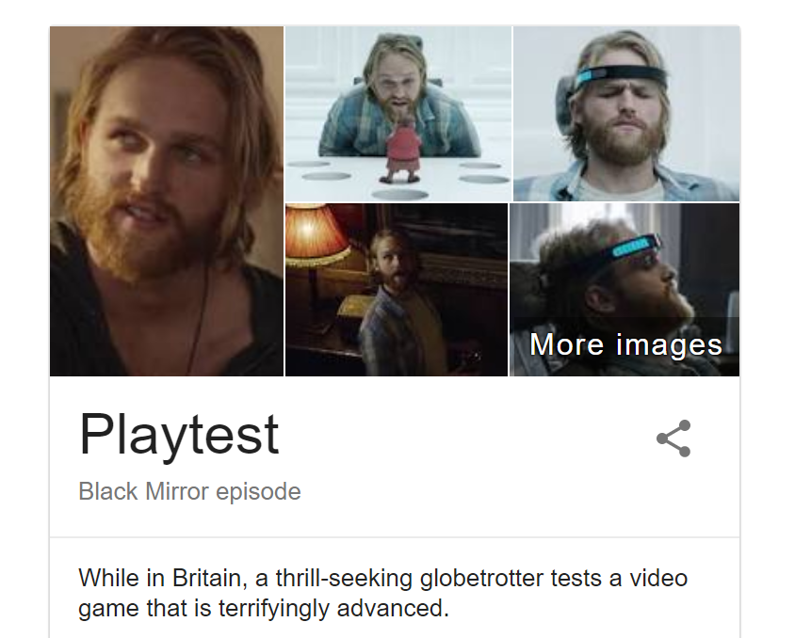
Machine learning

